Slide 1


Chapter 5
Divide and Conquer
Slides by Kevin Wayne.
Copyright © 2005 Pearson-Addison Wesley.
All rights reserved.

Slide 2
5.6 Convolution and FFT

Slide 3
Fast Fourier Transform: Applications
The FFT is one of the truly great computational developments of this [20th] century. It has changed the face of science and engineering so much that it is not an exaggeration to say that life as we know it would be very different without the FFT. -Charles van Loan
Notes:
Significance. Perhaps single algorithmic discovery that has had the greatest practical impact in history. Progress in these areas limited by lack of fast algorithms.
Variants of FFT used for JPEG, e.g., fast sine/cosine transforms

Slide 4
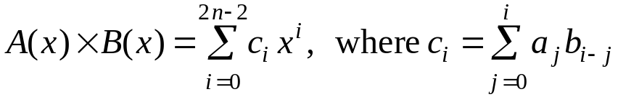
Polynomials: Coefficient Representation
Polynomial. [coefficient representation]
Add: O(n) arithmetic operations.
Evaluate: O(n) using Horner's method.
Multiply (convolve): O(n²) using brute force.
Notes:
can also multiply in O(n^1.585) using Karatsuba polynomial multiplication

Slide 5
Polynomials: Point-Value Representation
Fundamental theorem of algebra. [Gauss, PhD thesis] A degree n polynomial with complex coefficients has n complex roots.
Corollary. A degree n-1 polynomial A(x) is uniquely specified by its evaluation at n distinct values of x.
y
y_{j} = A(x_{j})
x_{j}
x
Notes:
deep theorem - proof requires analysis
conjectures in 17th century, but not rigorously proved until Gauss' phd thesis
established imaginary numbers as fundamental mathematical objects

Slide 6
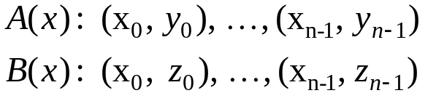
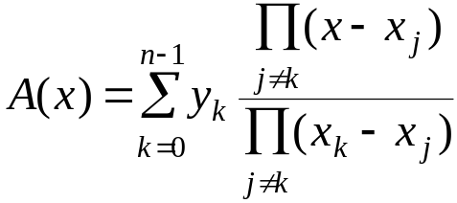
Polynomials: Point-Value Representation
Polynomial. [point-value representation]
Add: O(n) arithmetic operations.
Multiply: O(n), but need 2n-1 points.
Evaluate: O(n²) using Lagrange's formula.
Notes:
Lagrange's formula is numerically unstable

Slide 7
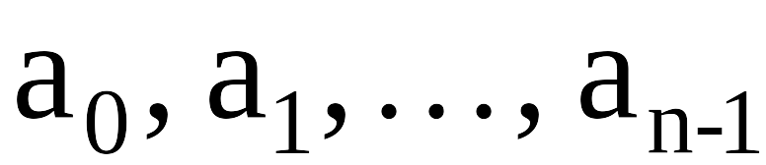
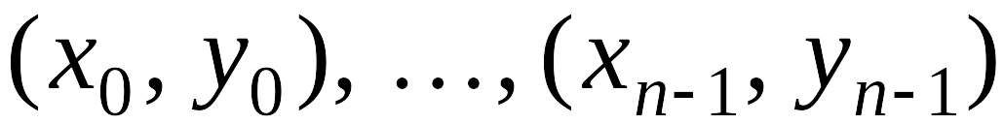
Converting Between Two Polynomial Representations
Tradeoff. Fast evaluation or fast multiplication. We want both!
Goal. Make all ops fast by efficiently converting between two representations.
Representation
Multiply
Evaluate
Coefficient
O(n²)
O(n)
Point-value
O(n)
O(n²)
coefficient
representation
point-value
representation

Slide 8
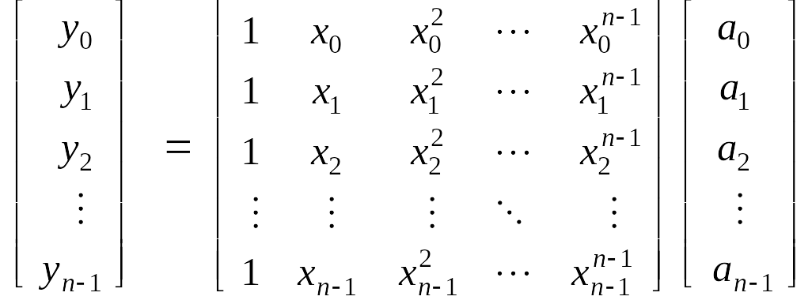
Converting Between Two Polynomial Representations: Brute Force
Coefficient to point-value. Given a polynomial a₀ + a₁ x + ... + a_{n-1} x^{n-1}, evaluate it at n distinct points x₀, ... , x_{n-1}.
Point-value to coefficient. Given n distinct points x₀, ..., x_{n-1} and values y₀, ..., y_{n-1}, find unique polynomial a₀ + a₁ x + ... + a_{n-1} x^{n-1} that has given values at given points.
O(n²) for matrix-vector multiply
O(n³) for Gaussian elimination
Vandermonde matrix is invertible iff x_{i} distinct

Slide 9
Coefficient to Point-Value Representation: Intuition
Coefficient to point-value. Given a polynomial a₀ + a₁ x + ... + a_{n-1} x^{n-1}, evaluate it at n distinct points x₀, ... , x_{n-1}.
Divide. Break polynomial up into even and odd powers.
  A(x) = a₀ + a₁x + a₂x² + a₃x³ + a₄x⁴ + a₅x⁵ + a₆x⁶ + a₇x⁷.
  A_{even}(x) = a₀ + a₂x + a₄x² + a₆x³.
  A_{odd} (x) = a₁ + a₃x + a₅x² + a₇x³.
  A(-x) = A_{even}(x²) + x A_{odd}(x²).
  A(-x) = A_{even}(x²) - x A_{odd}(x²).
Intuition. Choose two points to be ±1.
  A(-1) = A_{even}(1) + 1 A_{odd}(1).
  A(-1) = A_{even}(1) - 1 A_{odd}(1).
Can evaluate polynomial of degree ≤ n
at 2 points by evaluating two polynomials of degree ≤ ½n at 1 point.

Slide 10
Coefficient to Point-Value Representation: Intuition
Coefficient to point-value. Given a polynomial a₀ + a₁ x + ... + a_{n-1} x^{n-1}, evaluate it at n distinct points x₀, ... , x_{n-1}.
Divide. Break polynomial up into even and odd powers.
  A(x) = a₀ + a₁x + a₂x² + a₃x³ + a₄x⁴ + a₅x⁵ + a₆x⁶ + a₇x⁷.
  A_{even}(x) = a₀ + a₂x + a₄x² + a₆x³.
  A_{odd} (x) = a₁ + a₃x + a₅x² + a₇x³.
  A(-x) = A_{even}(x²) + x A_{odd}(x²).
  A(-x) = A_{even}(x²) - x A_{odd}(x²).
Intuition. Choose four points to be ±1, ±i.
  A(-1) = A_{even}(-1) + 1 A_{odd}( 1).
  A(-1) = A_{even}(-1) - 1 A_{odd}(-1).
  A(-i) = A_{even}(-1) + i A_{odd}(-1).
  A(-i) = A_{even}(-1) - i A_{odd}(-1).
Can evaluate polynomial of degree ≤ n
at 4 points by evaluating two polynomials of degree ≤ ½n at 2 points.

Slide 11
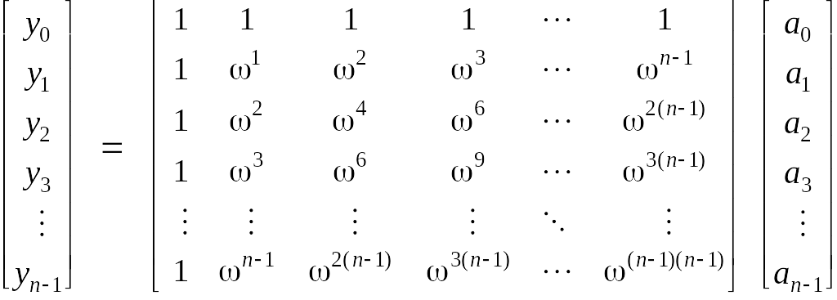
Discrete Fourier Transform
Coefficient to point-value. Given a polynomial a₀ + a₁ x + ... + a_{n-1} x^{n-1}, evaluate it at n distinct points x₀, ... , x_{n-1}.
Key idea: choose x_{k} = ω^{k} where ω is principal n^{th} root of unity.
Discrete Fourier transform
Fourier matrix F_{n}

Slide 12
Roots of Unity
Def. An n^{th} root of unity is a complex number x such that x^{n} = 1.
Fact. The n^{th} roots of unity are: ω⁰, ω¹, …, ω^{n-1} where ω = e ^{2π i / n}.
Pf. (ω^{k})^{n} = (e ^{2π i k / n}) ^{n} = (e ^{π i} ) ^{2k} = (-1) ^{2k} = 1.
Fact. The ½n^{th} roots of unity are: ν⁰, ν¹, …, ν^{n/2-1} where ν = e ^{4π i / n}.
Fact. ω² = ν and (ω²)^{k} = ν^{k}.
ω² = ν¹ = i
ω³
ω¹
ω⁴ = ν² = -1
n = 8
ω⁰ = ν⁰ = 1
ω⁵
ω⁷
ω⁶ = ν³ = -i
Notes:
forms a group under multiplication (similar to additive group Z_n modulo n)

Slide 13
Fast Fourier Transform
Goal. Evaluate a degree n-1 polynomial A(x) = a₀ + ... + a_{n-1} x^{n-1} at its n^{th} roots of unity: ω⁰, ω¹, …, ω^{n-1}.
Divide. Break polynomial up into even and odd powers.
  A_{even}(x) = a₀ + a₂x + a₄x² + … + a_{n/2-2} x^{(n-1)/2}.
  A_{odd} (x) = a₁ + a₃x + a₅x² + … + a_{n/2-1} x^{(n-1)/2}.
  A(x) = A_{even}(x²) + x A_{odd}(x²).
Conquer. Evaluate A_{even}(x) and A_{odd}(x) at the ½n^{th} roots of unity: ν⁰, ν¹, …, ν^{n/2-1}.
Combine.
  A(ω^{k+n}) = A_{even}(ν^{k}) + ω^{k} A_{odd}(ν^{k}), 0 ≤ k < n/2
  A(ω^{k+n}) = A_{even}(ν^{k}) - ω^{k} A_{odd}(ν^{k}), 0 ≤ k < n/2
ν^{k} = (ω^{k})² = (ω^{k+n})²
ω^{k+n} = -ω^{k}

Slide 14
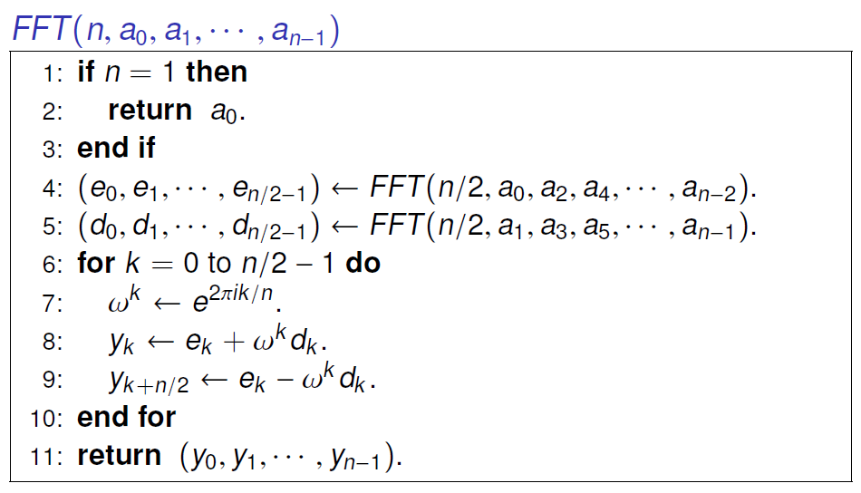
FFT Algorithm

Slide 15
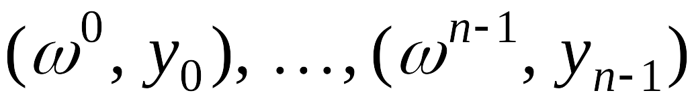
FFT Summary
Theorem. FFT algorithm evaluates a degree n-1 polynomial at each of the n^{th} roots of unity in O(n log n) steps.
Running time. T(2n) = 2T(n) + O(n) ⇒ T(n) = O(n log n).
assumes n is a power of 2
O(n log n)
coefficient
representation
point-value
representation

Slide 16
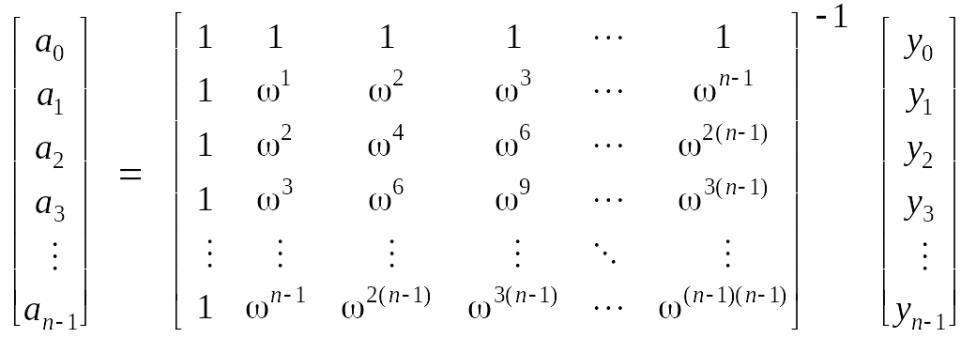
Point-Value to Coefficient Representation: Inverse DFT
Goal. Given the values y₀, ... , y_{n-1} of a degree n-1 polynomial at the n points ω⁰, ω¹, …, ω^{n-1}, find unique polynomial a₀ + a₁ x + ... + a_{n-1} x^{n-1} that has given values at given points.
Inverse FFT
Fourier matrix inverse (F_{n})⁻¹

Slide 17
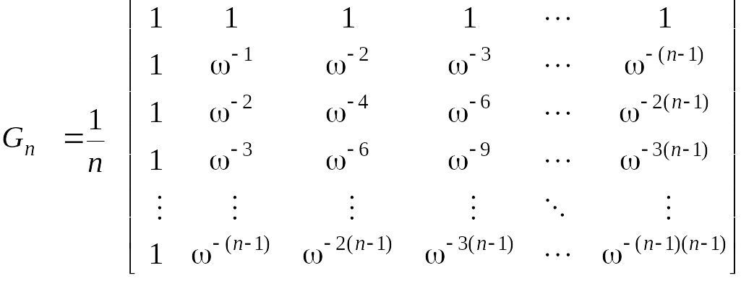
Inverse FFT
Claim. Inverse of Fourier matrix is given by following formula.
Consequence. To compute inverse FFT, apply same algorithm but use
ω⁻¹ = e ^{-2π i / n} as principal n^{th} root of unity (and divide by n).

Slide 18
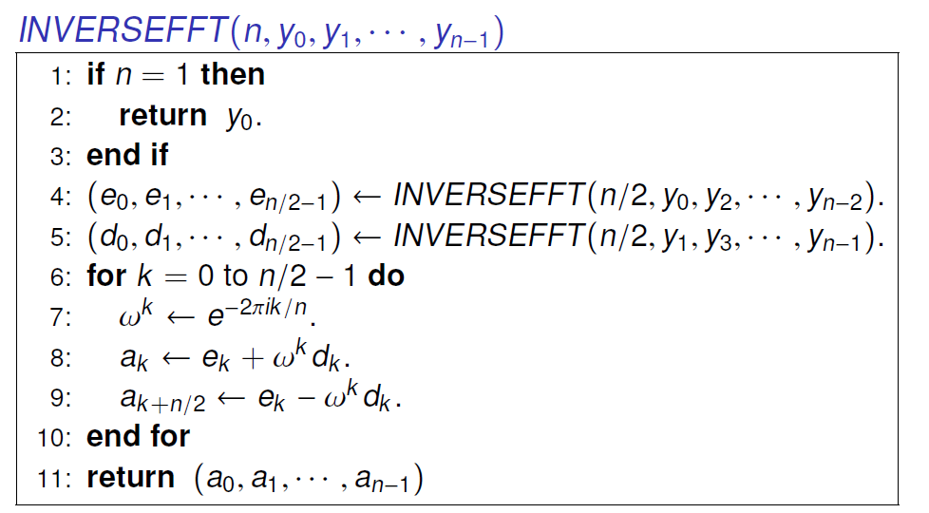
Inverse FFT: Algorithm
Remark. Need to divide result by n.

Slide 19
Inverse FFT Summary
Theorem. Inverse FFT algorithm interpolates a degree n-1 polynomial given values at each of the n^{th} roots of unity in O(n log n) steps.
assumes n is a power of 2
O(n log n)
coefficient
representation
O(n log n)
point-value
representation

Slide 20
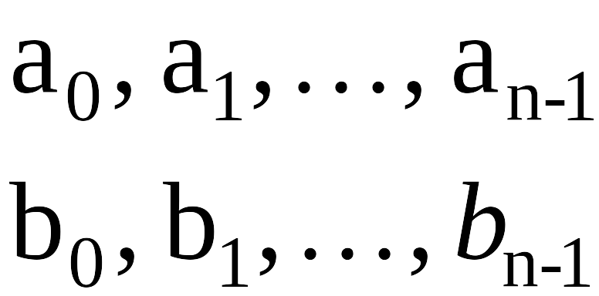
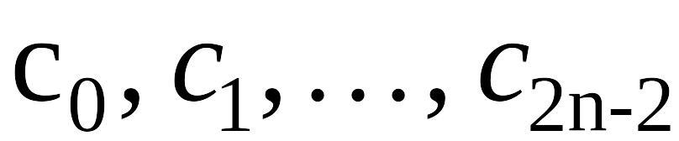
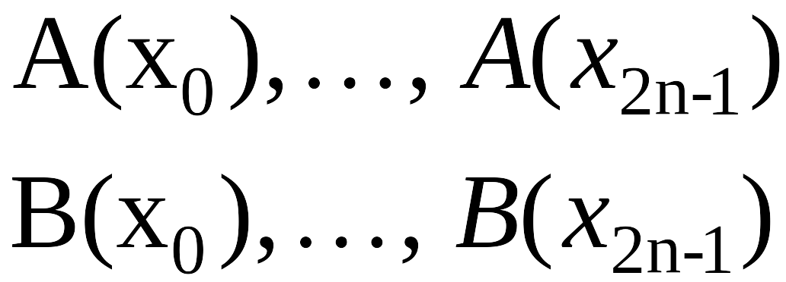
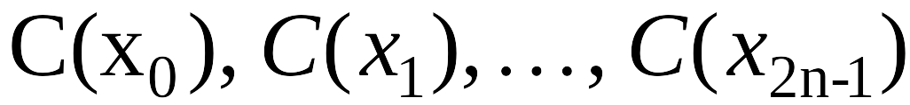
Polynomial Multiplication
Theorem. Can multiply two degree n-1 polynomials in O(n log n) steps.
coefficient
representation
coefficient
representation
FFT
O(n log n)
inverse FFT
O(n log n)
point-value multiplication
O(n)

Slide 21
Integer Multiplication
Integer multiplication. Given two n bit integers a = a_{n-1} … a₁a₀ and
b = b_{n-1} … b₁b₀, compute their product c = a × b.
Convolution algorithm.
  Form two polynomials.
  Note: a = A(2), b = B(2).
  Compute C(x) = A(x) × B(x).
  Evaluate C(2) = a × b.
  Running time: O(n log n) complex arithmetic steps.
Theory. [Schönhage-Strassen 1971] O(n log n log log n) bit operations.

Slide 22
Homework
Read Chapter 5 of the textbook.
Exercises 3 & 4 in Chapter 5.

